Slide 1
Organizational Behavior
Topic: Formation of group
Dr. C. Vijaya Banu
Associate Professor , School of Management
SASTRA Deemed University, Thanjavur – 613 401
vijayabanu@mba.sastra.edu

Slide 2
Classical Theory
Developed by George Homans, suggests that groups develop based on activities interactions, and sentiments.
• Basically, the theory means that when individuals share common activities, they will have more interaction and will develop attitudes (positive or negative) toward each other.
• The major clement in this theory is the interaction of the individuals involved.

Slide 3
Social exchange Theory
Offers an alternative explanation for group development.
According to this theory individuals form relationships based on the implicit expectation of mutually beneficial exchanges based on trust and felt obligation.
• Thus, a perception that exchange relationships will be positive is essential if individuals are to be attracted to and affiliate with a group.

Slide 4
Social Identity
Offers another explanation for group formation. • Simply put, this theory suggests that individuals get a sense of identity and self-esteem based upon their membership in salient groups.
The nature of the group may be demographically based, culturally based, or organizationally based.
Individuals are motivated to belong to and contribute to identity groups because of the sense of belongingness and self-worth membership in the group imparts.

Slide 5
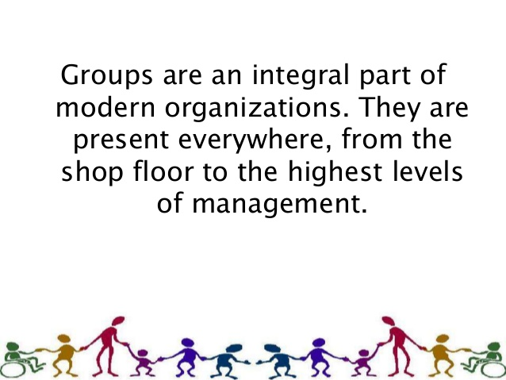

Slide 6
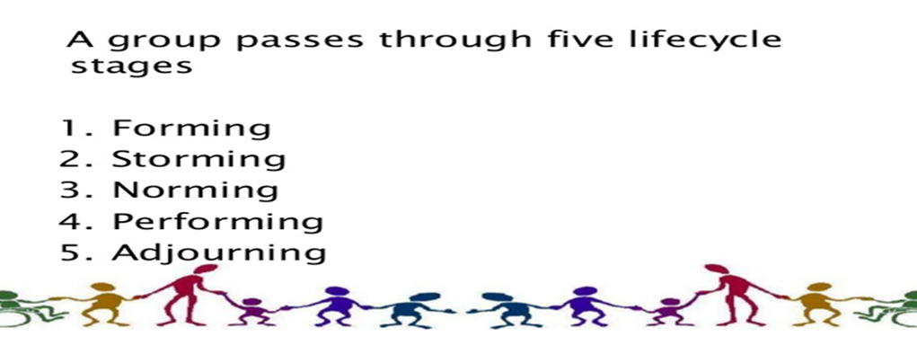
Tuckman Theory of group formation

Slide 7
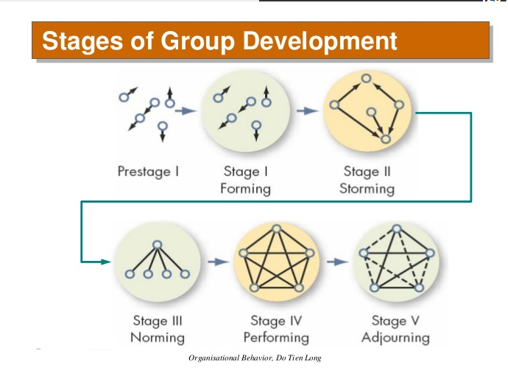

Slide 8
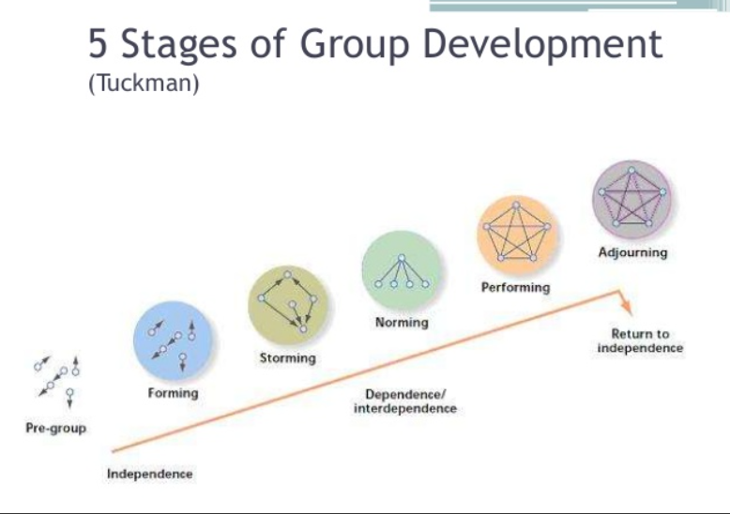

Slide 9
The Five-Stage Model of Group Development
1
Forming:
Uncertainty about purpose, structure, and leadership
2
Storming:
Intragroup conflict as members resist constraints
3
Norming:
Group is cohesive with strong group identity
4
5
Performing:
Adjourning:
Group fully functional and working toward goals
For temporary groups: breaking up

Slide 10
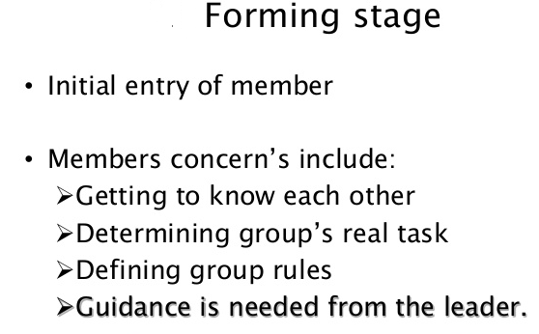
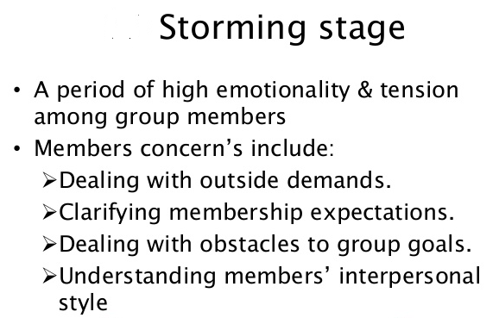
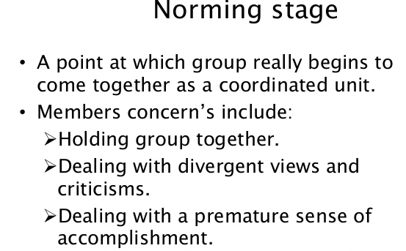
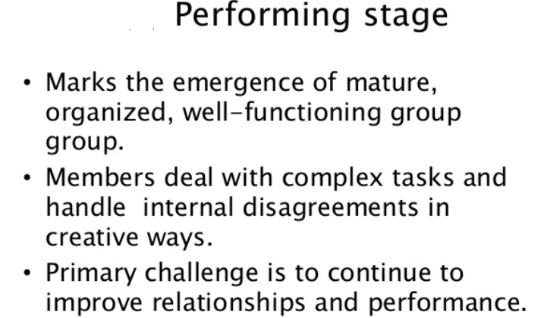
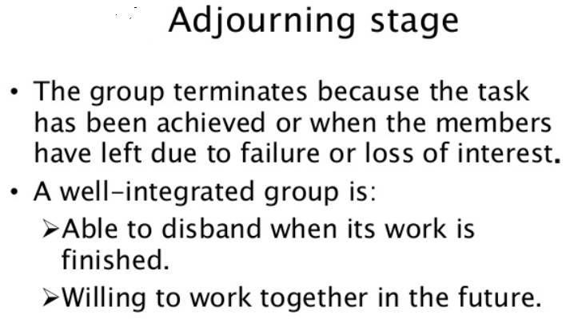
Formation of group

Slide 11
Key Points & Critique of Five-Stage Model
Group Effectiveness:
Generally groups are more effective as they progress
Reasons for this are complex
Group Conflict:
Some groups need conflict, most productive in Stage II
Blurred Stages:
Stages not always sequential
Multiple stages may be taken simultaneously
May regress a stage

Slide 12
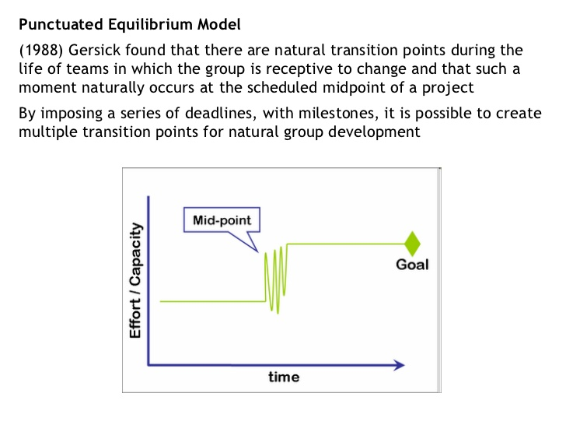

Slide 13
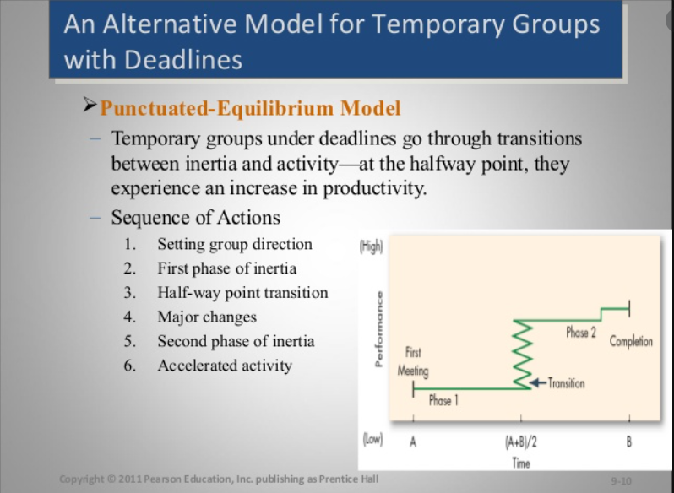

Slide 14
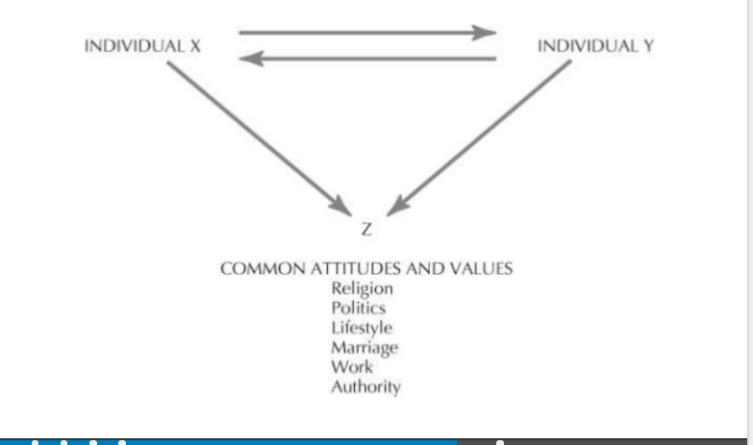
Balance Theory
Propounded by “ Theodore New-Comb” which states that- “ Persons are attracted with one another on the basis of similar attitudes towards commonly relevant objectives and goals.”

Slide 15
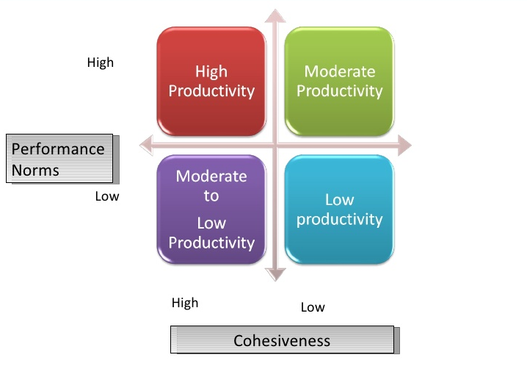
Group Cohesiveness and productivity

Slide 16
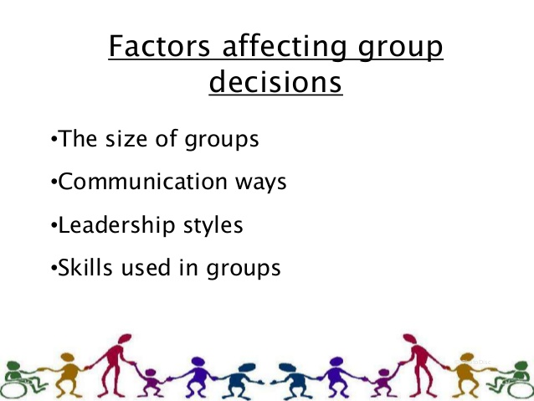

Slide 17
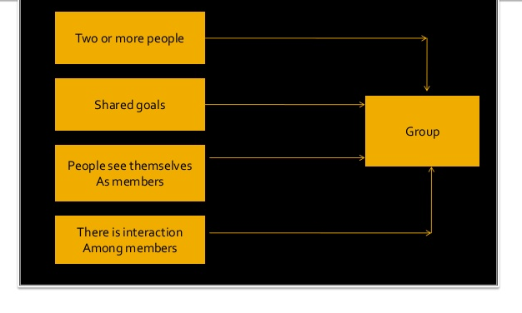
What is group

Slide 18
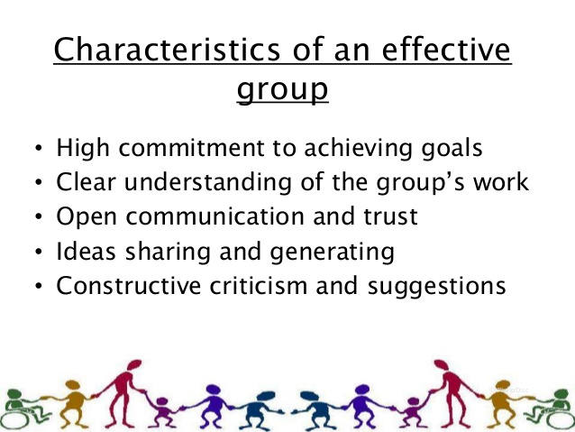

Slide 19
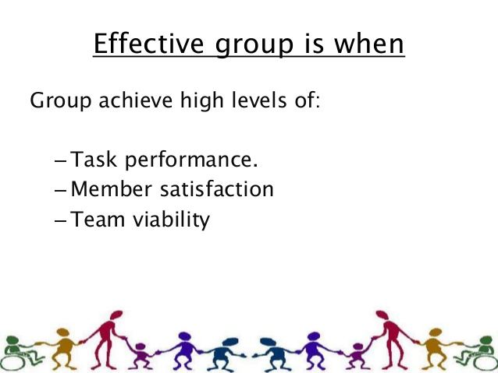

Slide 20
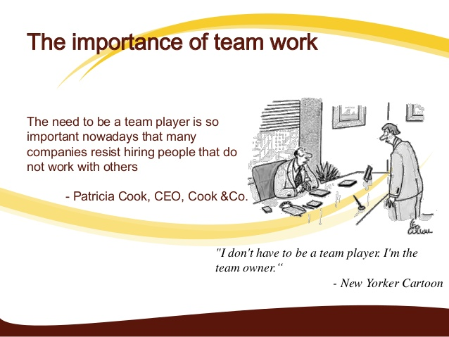

Slide 21


